Slide 1
Apache Arrow

Slide 2
JAVA
PYTHON
Serialization/ Deserialization
Both ends are binary compatible. They need serialization and deserialization of data to talk to each other.
PYTHON
DATABASE
Serialization/ Deserialization
JAVA

Slide 3
We need complete conversion to go from spark data frame to pandas' data frame
Java
(Apache Spark)
Python
(Pandas)
In-memory columnar data format
Using Apache arrow on both sides we don’t need to serialize and deserialize the data as both sides
Understand the format of data that is coming.
Apache arrow has the capability to tell itself what the data is all about

Slide 4
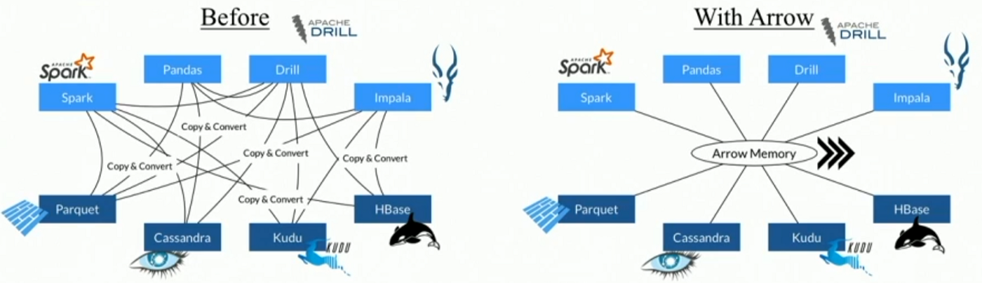
It facilitates communication between many components – arrow as high-performance interface for data exchange
Using Apache arrow, we don’t do copy and convert

Slide 5
Columnar format data processing
Helps to write data processing algorithms in CPU efficient manner.
Allows to accelerate the analytics on hardware like single instruction and multiple data.
Arrows can act as centralized data formatting store for data exchange between different systems.

Slide 6
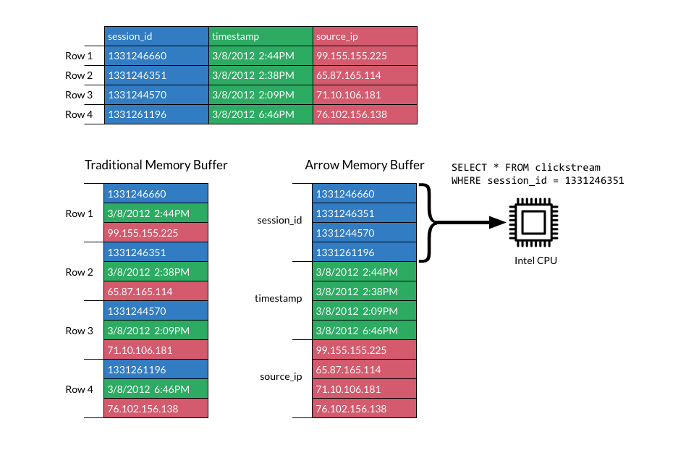
How does the data look like in memory
All the values are stored in columnar format in memory on disk for efficient computation.
- Encode the data of same type together.
- Compression works better for homogeneous data.
- Using columnar data representation, we can skip the entire column and go to next location directly to read the data.

Slide 7
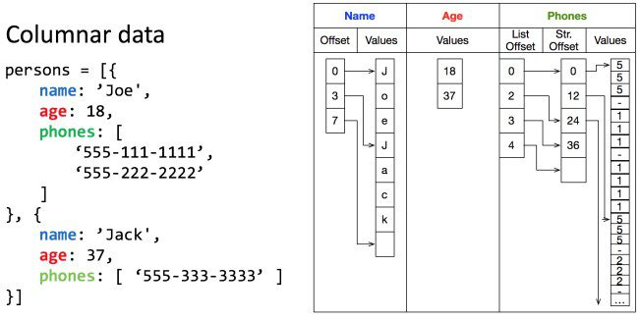
- Columnar representation of data in arrow.
- Storage of all the values one after the other and preserve structure of data
Offset vector – pointing to beginning of each list and other vector for holding the values
Here we have pointers(offset) to buffers. Copy those buffers to network where we have one buffer per column.
From incoming network buffer, we can directly read the data.
Data coming from the network has in-memory representation. Thus, we have all column buffers we can access.

Slide 8
ACTUAL DATA: [“A”, “B”, “C”, ”B”, ”A”, ”C”, ”B”]
<schema>
Description of the data structure
<Dictionary Batch 0>
0, “A”
1, “B”
2, “C”
<Record Batch 0>
0 1 2 1 0 2 1

Slide 9
Buffers - Object containing a pointer to a piece of contiguous memory with a particular size. Buffers have two related notions of length: size and capacity. Size is the number of bytes that might have valid data.
Offset - Offsets represent the starting position of each map.
Record Batch - A record batch is a collection of equal-length arrays matching a particular Schema. It is a table-like data structure that is semantically a sequence of fields, each a contiguous Arrow Array.
A memory-mapped file contains the contents of a file in virtual memory. This mapping between a file and memory space enables an application, including multiple processes, to modify the file by reading and writing directly to the memory

Slide 10
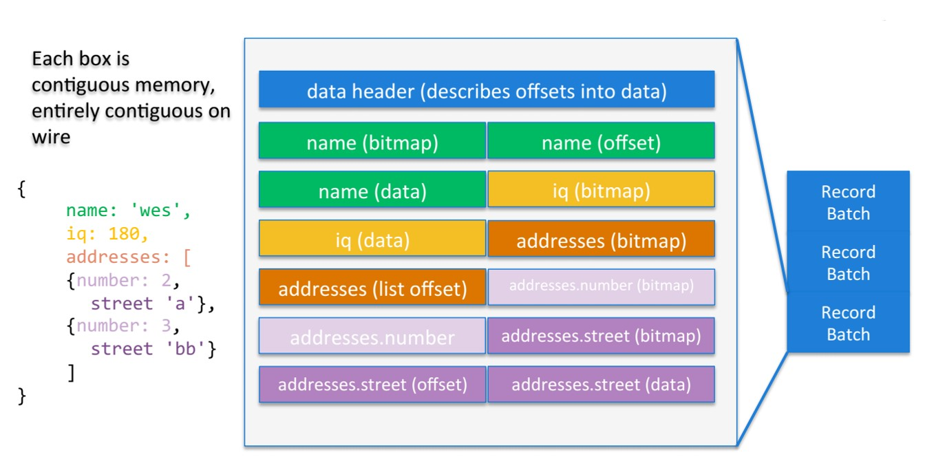
Record Batch – In memory representation
Header -> Metadata – size, type of each column
Bitmap – if value is defined null bitmap value is 0 or 1
Offset - vectors for beginning of each string
No transformation into in-memory pointers
No transformation required at the other end where we require our data. This process is serialization free.

Slide 11
Exchanging data smoothly
Before Arrow, the standard way of exchanging data between any application or library was to store it to disk in one way or the other.
Both steps, the writing (serialization) and reading (deserialization) are costly and slow — and the bigger the dataset, the longer it takes to complete each of them.
Arrow is a way to exchange the data directly via handshake and zero copying
Applications can directly operate on a dataset stored on disk without the need to fully load it into memory.

Slide 12
Memory-mapped format
“Arrow serialization design provides a ‘data header’ which describes the exact locations and sizes of all the memory buffers for all the columns in a table. This means you can memory map huge, bigger-than-RAM datasets and evaluate pandas-style algorithms on them in-place without loading them into memory like you have to with pandas now. You could read 1 megabyte from the middle of a 1 terabyte table, and you only pay the cost of performing those random reads totaling 1 megabyte.”

Slide 13
Advantages
Optimized for data exchange and fast retrieval → Arrow
The performance gains of Arrow are significant compared to csv.
If Arrow is read with the memory-mapping function, the reading performance is incredible.
The best case is when the dataset has no missing values/NaNs. Then PyArrow perform faster and allow to operate on the table, consuming no memory.

Slide 14
REFERENCES
https://towardsdatascience.com/a-gentle-introduction-to-apache-arrow-with-apache-spark-and-pandas-bb19ffe0ddae
https://www.robinlinacre.com/demystifying_arrow/
https://www.orchest.io/blog/the-great-python-dataframe-showdown-part-1-demystifying-apache-arrow
https://towardsdatascience.com/apache-arrow-read-dataframe-with-zero-memory-69634092b1a
https://techascent.com/blog/memory-mapping-arrow.html
https://xuechendi.github.io/2019/04/16/Apache-Arrow
https://arrow.apache.org/cookbook/py/io.html
https://www.kdnuggets.com/2017/02/apache-arrow-parquet-columnar-data.html

